Slide 1
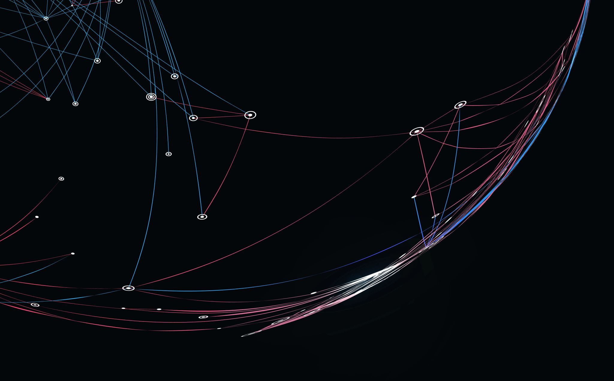
Implementing Support Vector Machine (SVM)
Colin Beveridge, Pemba Sherpa, Ben Grudt, Amy Yucus

Slide 2
Overview
Chosen Dataset
Logistic Regression Performance
SVM Performance
Comparison
Increasing Performance

Slide 3
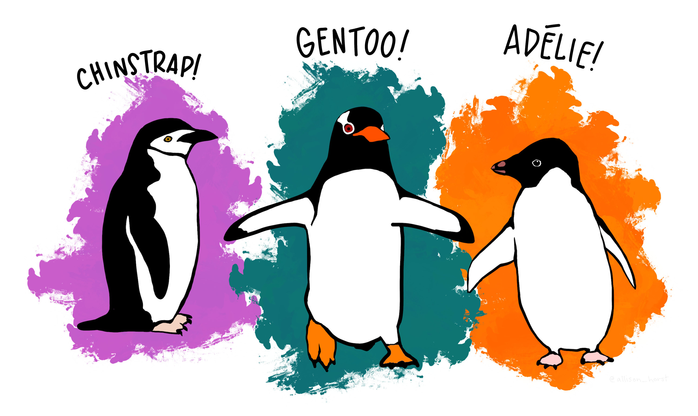
Penguin Dataset
Got tired of the diabetes dataset
Took original dataset from Kaggle
Target: Species
Notes:
“Data set chosen is appropriate for the algorithm being used.”

Slide 4


Logistic Regression Performance
Confusion Matrix:
Score: 1.0
Diagonal confusion matrix indicates no misclassifications
Notes:
“Code samples are presented. & Process is documented and explained in the presentation.”

Slide 5

SVM Performance: Linear Kernel
Confusion Matrix:
Score: 1.0
One more diagonal confusion matrix.
Notes:
“Code samples are presented. & Process is documented and explained in the presentation.”

Slide 6

SVM Performance: RBF Kernel
Confusion Matrix:
Score: 1.0
Another diagonal confusion matrix, like logistic regression.
Note: Cannot get coefficients for non-linear kernels.
Notes:
“Code samples are presented. & Process is documented and explained in the presentation.”

Slide 7
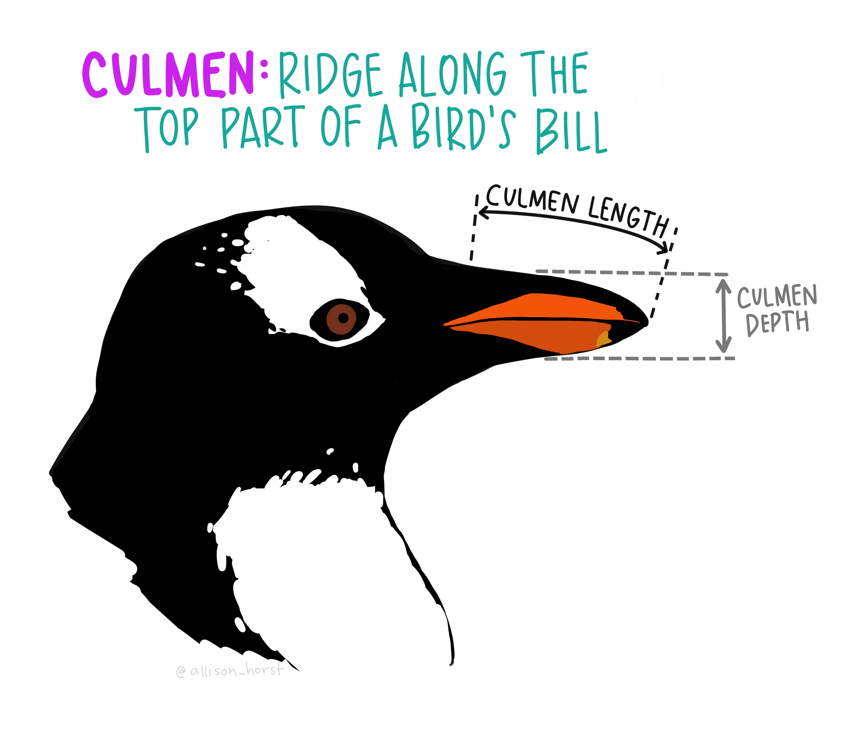
Reasons for results
Data may be entered in a way that makes classification easy
Not a difficult classification problem
User error
Blind luck
Notes:
“At least one idea has been shared that might increase performance of the presented model.”

Slide 8

Summary
Processed data by removing irrelevant columns and missing data
Used logistic and SVM objects from scikit learn
Both logistic and SVM methods provided the same results
Generated a 3x3 confusion matrix due to having 3 species

Slide 9

Questions?

Slide 10

Source
https://www.kaggle.com/parulpandey/penguin-dataset-the-new-iris/notebook

